Slide 1
Chap 7

Slide 2
Calibration and Validation of Model
Validation is the overall process of comparing the model and its behavior to the real system and its behavior.
Calibration is the iterative process of comparing the model to the real system.
Making adjustment or changes to the model comparing the Making adjustment or changes to the model, comparing the revised model to reality and so on.
The comparison of the model to reality is carried out by subjective and objective tests.
A subjective test involves talking to people, who are knowledgeable about the system making models and forming knowledgeable about the system making models and forming the judgment.
-Objective tests involve one or more statistical tests to compare some model output with the assumptions in the model

Slide 3
Calibration and validation of models
For a given program, while common sense verification is possible, strict verification of a model is intractable, very much similar to the proof of correctness of a program much similar to the proof of correctness of a program.
Validation is a process of comparing the model and its behavior to the real system and its behavior.
Calibration is the iterative process of comparing the model Calibration is the iterative process of comparing the model with real system, revising the model if necessary, comparing again, until a model is accepted (validated)
Naylor and Finger Simulation Model Validation:
Naylor and Finger proposed three step approach for validation process. These steps are as follows: 1. Face Validity 2. Validate Model Assumptions 3. Input - Output Transformation

Slide 4
Face Validity
Build a ``reasonable model'' on its face to model users who are knowledgeable about the real system being simulated.

Slide 5
Validation of Model Assumptions
Model assumptions fall into two categories: structural assumptions and data assumptions.
Structural assumptions deal with such questions as how the Structural assumptions deal with such questions as how the system operates, what kind of model should be used, queueing, inventory, reliability, and others.
Data assumptions: what kind of input data model is? What Data assumptions: what kind of input data model is? What are the parameter values to the input data model?

Slide 6
Validating Input -Output Transformations
View the model as a black box
Feed the in put at one end and examine the output at the other end
Use the same input for a real system, compare the output with the model output If they fit closely, the black box seems working fine
Otherwise, something is wrong

Slide 7
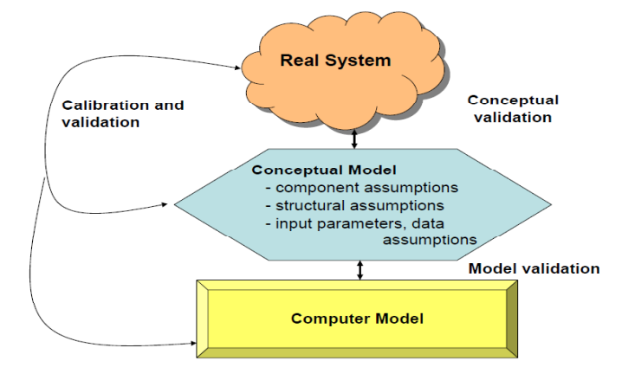
From modeling to simulation: model building, verification and validation

Slide 8
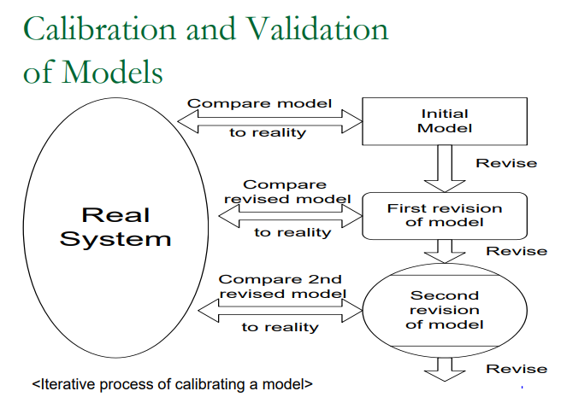
Model Calibration and Validation

Slide 9
Input Validation using Turing Test
Use in addition to statistical test, or when no statistical test is readily applicable.
Turing Test Described by Alan Turing in 1950. A human jugde is involved in a natural language conversation with a human and a machine. If the judge cannot reliably tell which of the partners is the machine then the machine has passed the test
• Utilize persons’ knowledge about the system.
• For example:
• Present 10 system performance reports to a manager of the system. Five of them are from the real system and the rest are “fake” reports based on simulation output data.
• If the person identifies a substantial number of the fake reports, interview the person to get information for model improvement.
• If the person cannot distinguish between fake and real reports with consistency, conclude that the test gives no evidence of model inadequacy.

Slide 10
initial bias
When simulation starts, the system usually begins in an unrealistic empty state.
This causes initial bias (also called initialization bias).
Example:
Queue starts empty.
Real system already has customers.
Removing these early observations improves accuracy.

Slide 11
Elimination of initial bias
The initial bias as shown in figure below needs to be removed.
Two general approaches can be taken into remove the bias.
1. The system can be started in a more representative then an empty state.
2. The first part of the simulation can be removed.

Slide 12
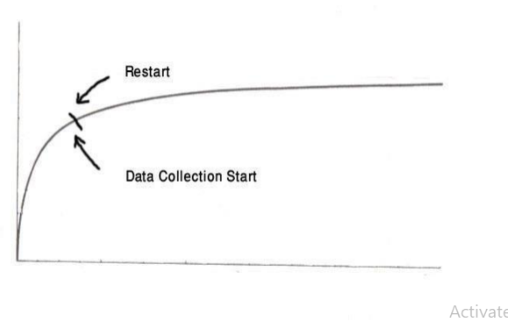
Elimination of initial bias
The ideal situation is to know the steady state distribution for the system and select the initial condition for the distribution.
The more common approach to know the initial bias is to eliminate on initial selection of runs.
The run is started from an idle state and stop after the certain period of time. The run is then restarted with statistics being gathered form the point of restart.

Slide 13
Elimination of initial bias
It is usual to program the simulation so that statistics are gathered from the beginning and simply wipe out the statistics gathered up to the point of restart.
No sample rules can be given beside how long an interval should be eliminated.
Advantages
More accurate results
Less bias
Better statistical analysis
The disadvantage of eliminating the first part of the simulation run is that the estimate of the variance needed to estimate a confidence limit, mostly based on less information.

Slide 14
Regression Analysis
Regression Analysis is a statistical method used to understand the relationship between input features and a target value that varies across a continuous numeric range. It helps measure how changes in different factors affect the outcome, allowing better predictions, planning and decision-making across various fields
Regression Analysis is a statistical technique used in simulation to determine the relationship between one dependent variable and one or more independent variables. It helps predict future outcomes, estimate unknown values, and understand how changes in input variables affect the simulation output.

Slide 15
Types of Regression
Some commonly used regression techniques are:
Linear Regression: Models straight-line relationships between predictors and outputs.
Multiple Regression: Uses multiple input features to predict one continuous outcome.
Polynomial Regression: Captures non-linear patterns by transforming input variables.

Slide 16
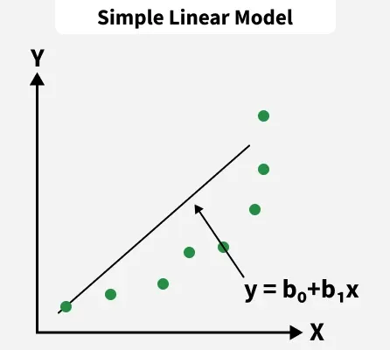
Linear Regression
Linear Regression forms a straight line relationship between independent variables and the target. It is simple, interpretable and used in analytics and forecasting tasks.
Y=β₀​+β₁​X+ϵ
Where:
Y is the predicted value,
β0​ is the intercept,
β1​is the coefficient affecting X,
ϵis the error term.

Slide 17
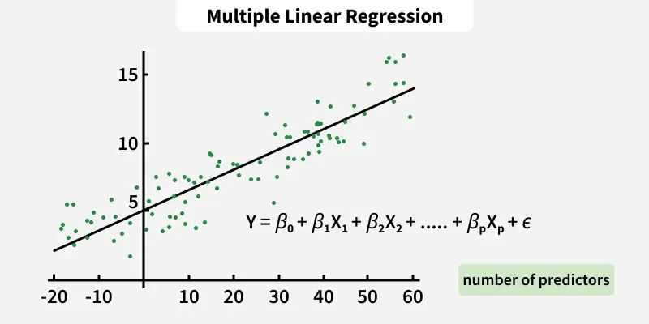
2. Multiple Regression
Multiple Regression extends linear regression by including several independent variables. It is useful when multiple factors jointly affect the output.
Y=β0​+β1​X1​+β2​X2​+…+βn​Xn​+ϵ
Where
Y is the predicted output,
X1​,X2​,…,Xn​are independent input variables,
β0​is the intercept term,
β1,β2,…,βn ​are weight of each feature,
n is number of input variables,
ϵ is the error term.

Slide 18
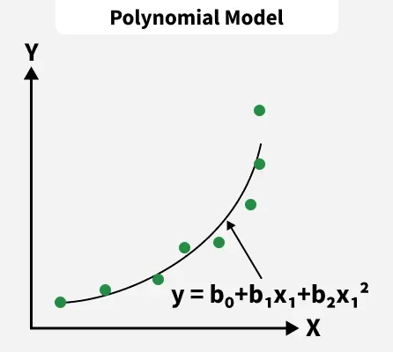
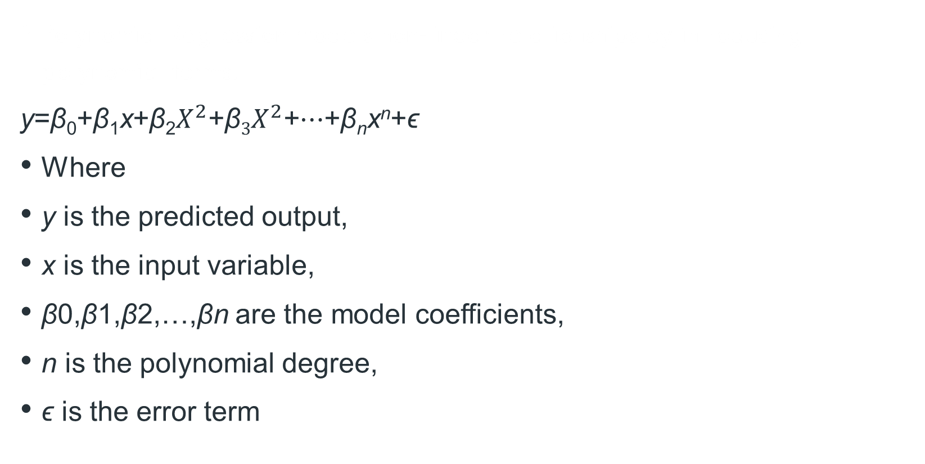
3. Polynomial Regression
Polynomial Regression models non-linear relationships by introducing polynomial terms.
y=β_{0​}+β₁​x+β₂​$X^{2}$+β$3$​$X^{2}$+⋯+β_{n}​x^{n}+ϵ
Where
y is the predicted output,
x is the input variable,
β0​,β1​,β2​,…,βn​ are the model coefficients,
n is the polynomial degree,
ϵ is the error term

Slide 19
Applications in Simulation
Predicting system performance.
Forecasting production output.
Queue and waiting time analysis.
Inventory management.
Traffic simulation.
Healthcare simulation.
Manufacturing process optimization.
Financial and economic simulations.

Slide 20
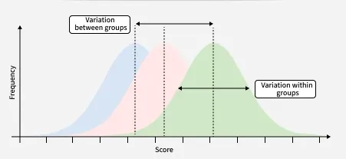
Analysis of Variance (ANOVA)
Analysis of Variance (ANOVA) is a statistical technique used to determine if there are significant differences between the average values (means) of two or more independent groups. It works by examining the spread of data within each group compared to the spread between the groups, helping researchers understand if observed differences are likely real or just due to random chance. It is widely used in research, including medicine, to compare treatments, interventions, or conditions.

Slide 21
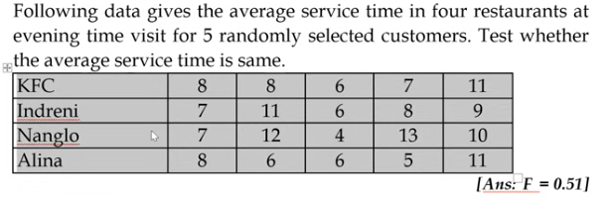
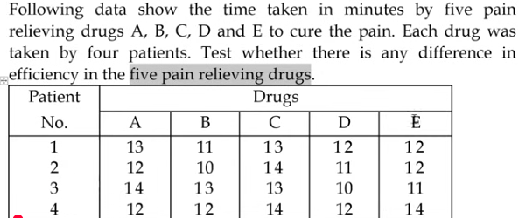
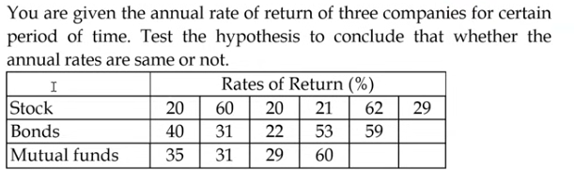
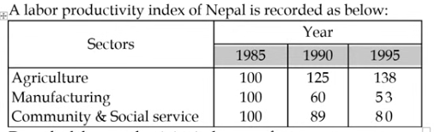
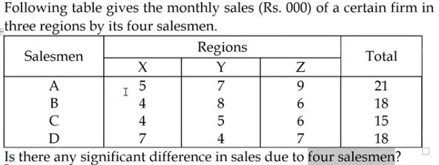

Slide 22
Types of ANOVA
ANOVA is mainly classified into two types based on the number of independent variables (factors) being studied.
1. One-Way ANOVA (or One-Factor)
One-Way ANOVA is used to compare the means of three or more groups when there is only one independent variable. It helps determine whether the differences among the group means are statistically significant.
Example: Comparing the average test scores of students taught using three different teaching methods.
2. Two-Way ANOVA (or Two-Factor)
Two-Way ANOVA is used when there are two independent variables. It evaluates the effect of each factor on the dependent variable and also determines whether the two factors interact with each other.
Example: Studying how students' test scores are affected by both the teaching method and the number of study hours.

Slide 23
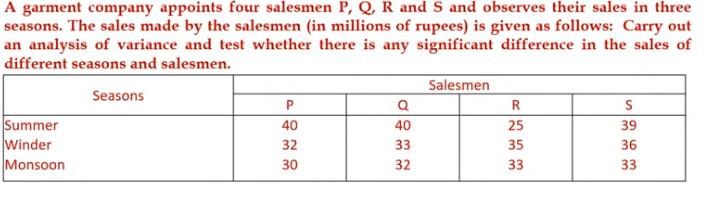
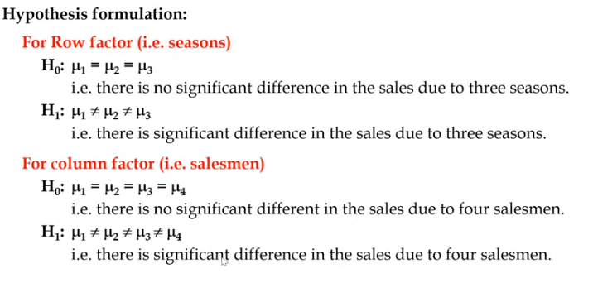

Slide 24
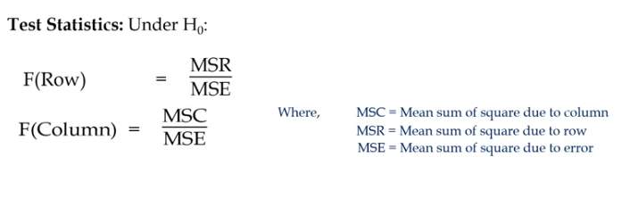
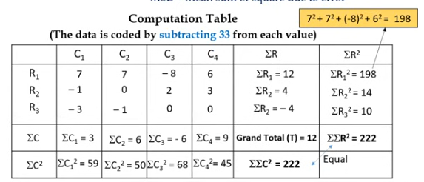

Slide 25
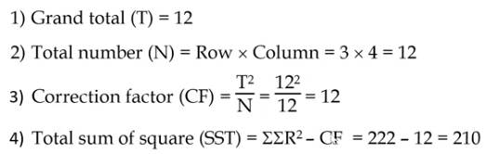
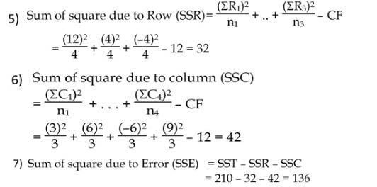
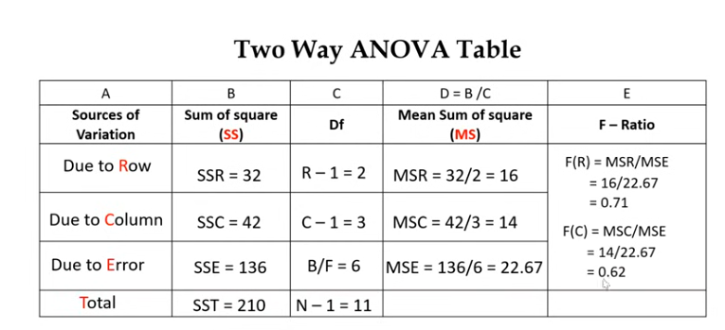

Slide 26
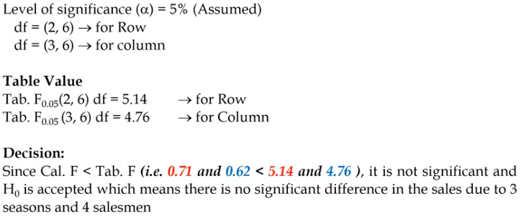

Slide 27
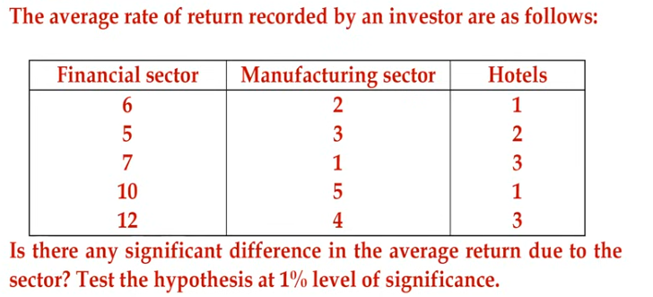
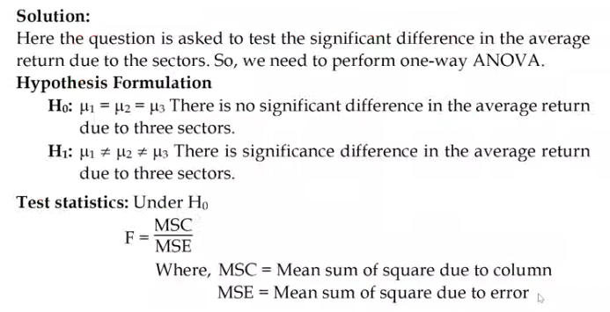

Slide 28
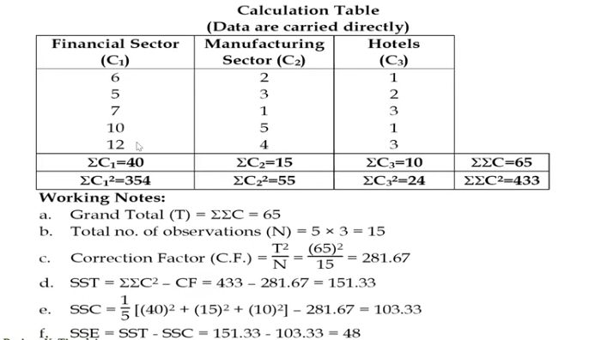

Slide 29
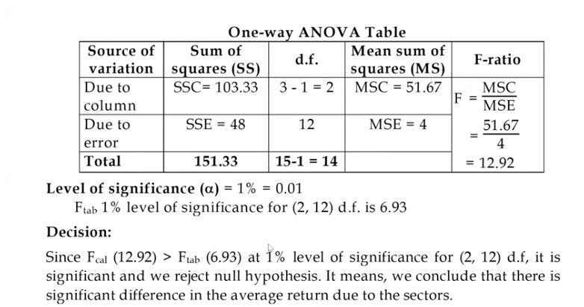

Slide 30
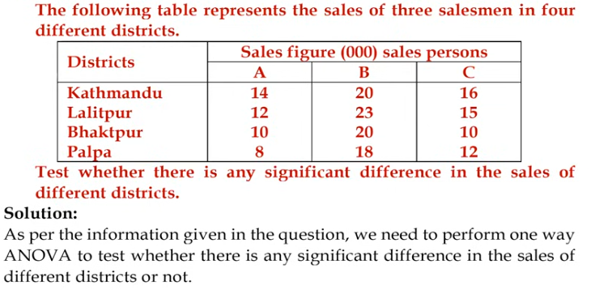

Slide 31
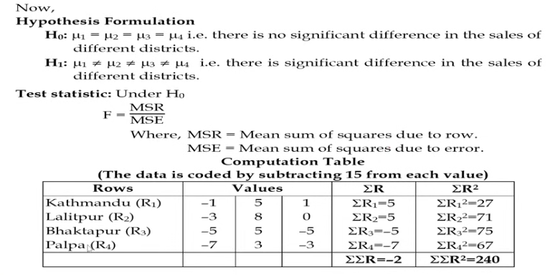

Slide 32
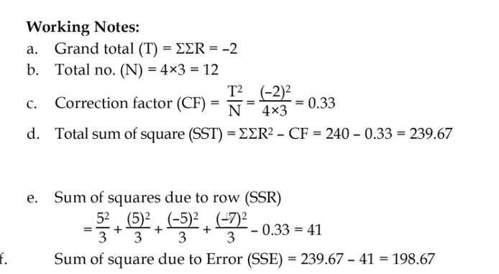

Slide 33
